Slide 1

Fall 2024 Baseline Measurements
By Jonah Zembower

Slide 2
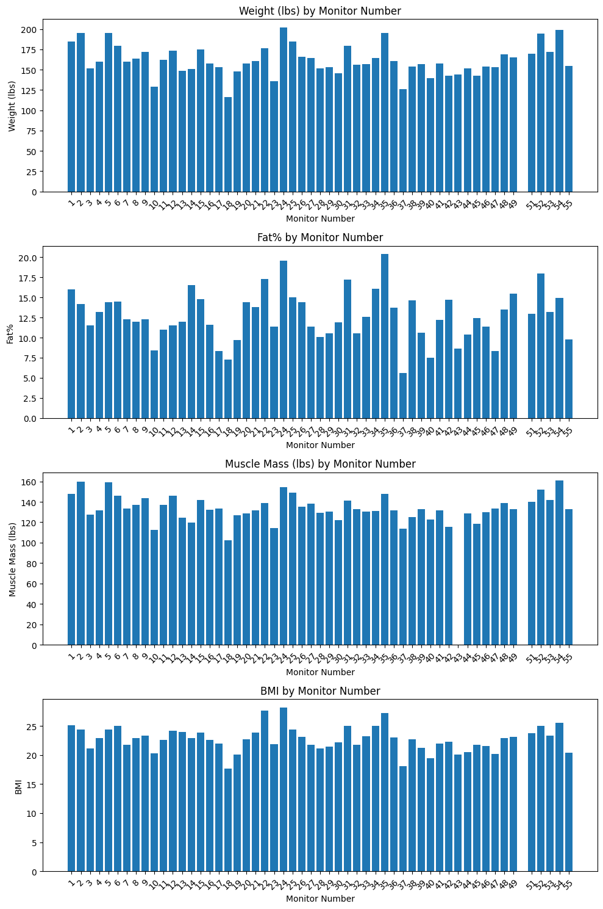
Body Composition Data
Fat% typically in a good range 15% and below.
A couple fat percentages close to 20 are concerningly high.

Slide 3
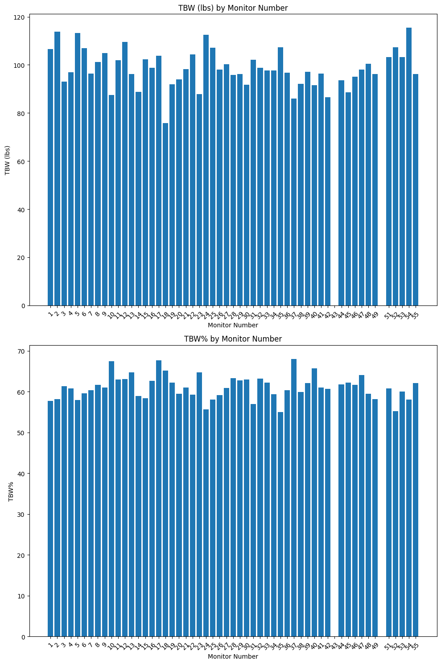
Hydration Status
Most are in the 60% range and above.
Would like to see a couple of those higher than mid 50’s.

Slide 4
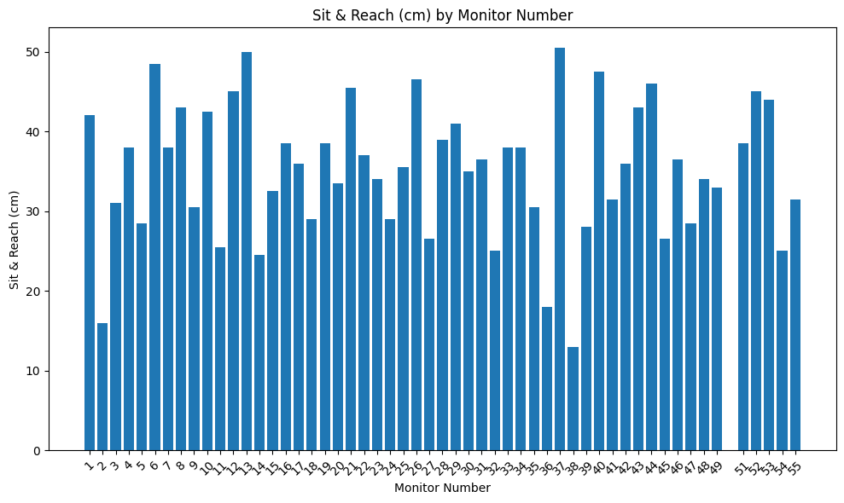
Sit and Reach Test
Relatively good values according to the normative data.
We saw higher values than last semester.
We want to see 40 and above if at all possible.
Some players could use a stretching implementation.

Slide 5
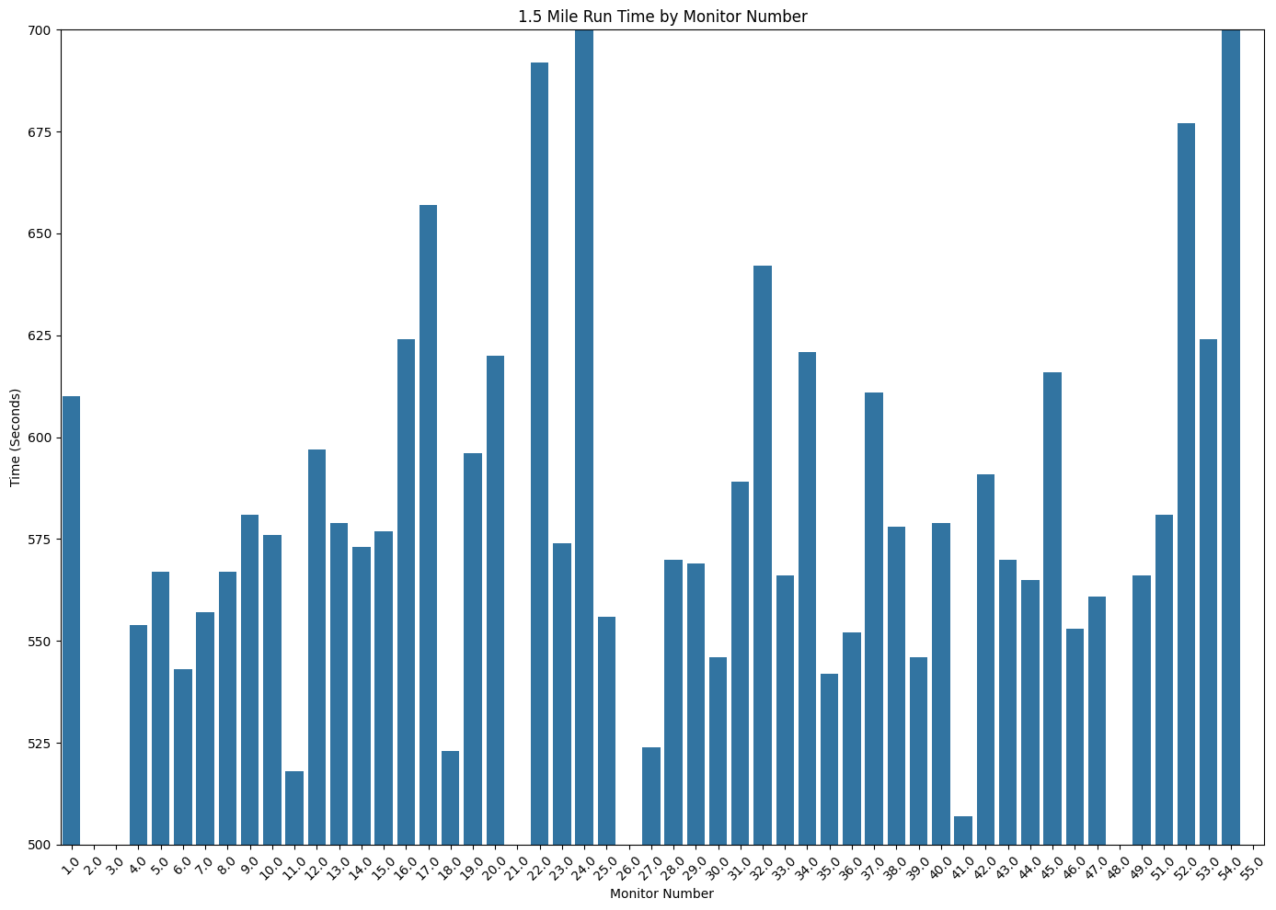
1.5 Mile Run Data
Some of the times were concerningly slow.
Generally, we found some good times at around 8-9 minutes.

Slide 6
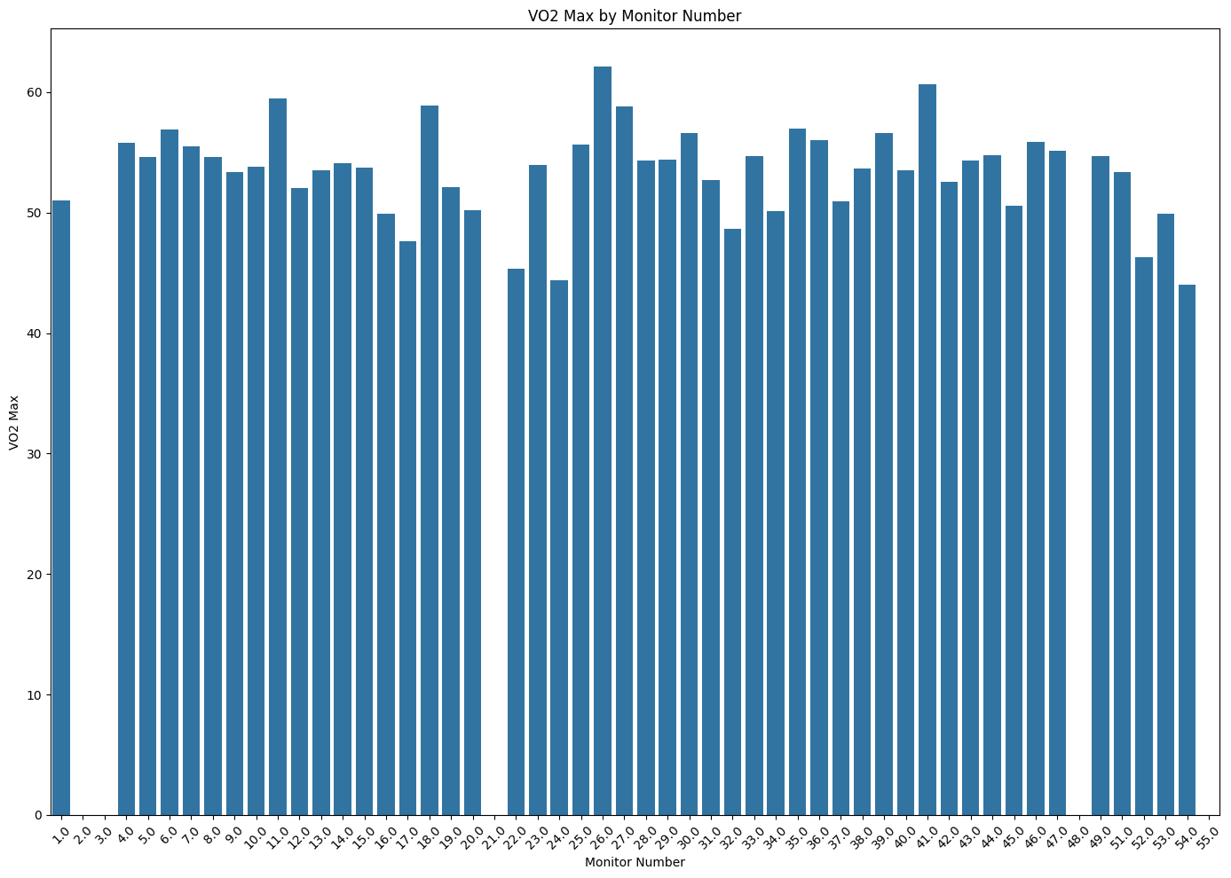
VO2 Max Calculations
Here are some of the VO2 Max Calculations.
This is generally good to see. We want most values in the 50-60s.
The couple players in the 60s are definitely good candidates when we need them to press or play long amounts of time under high stress.

Slide 7
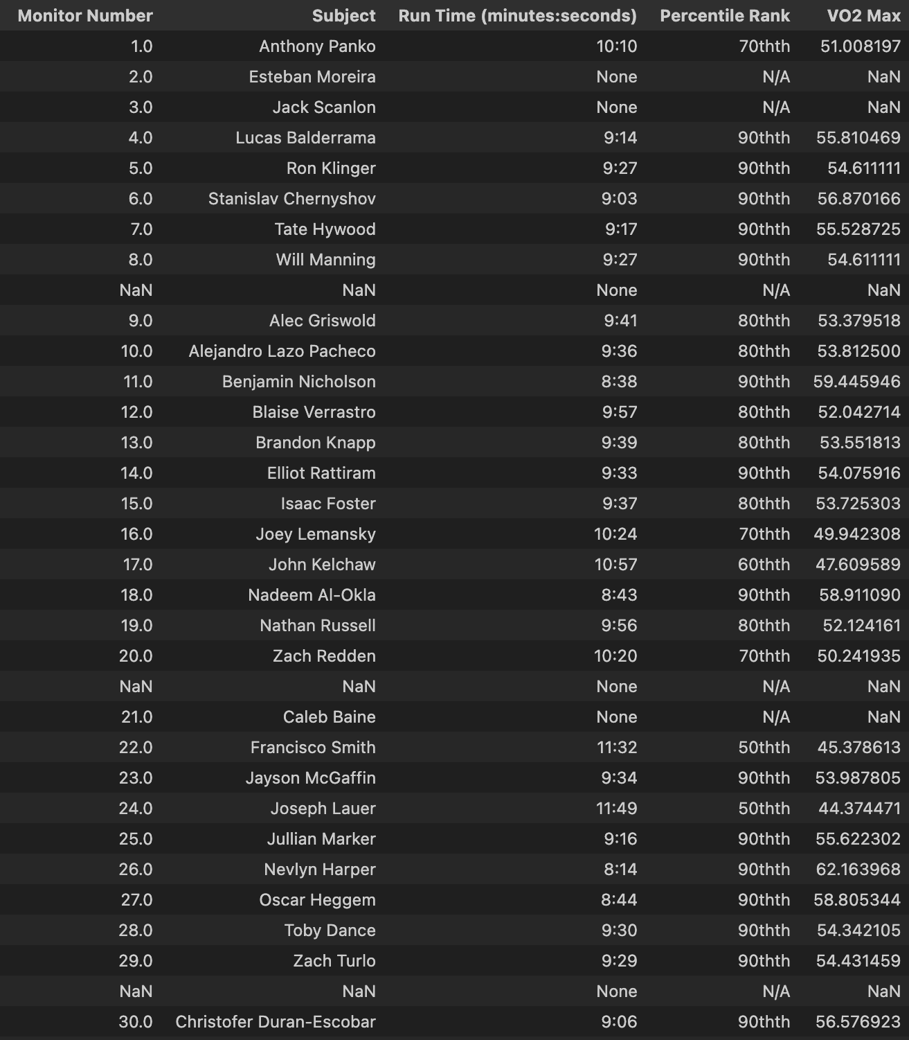
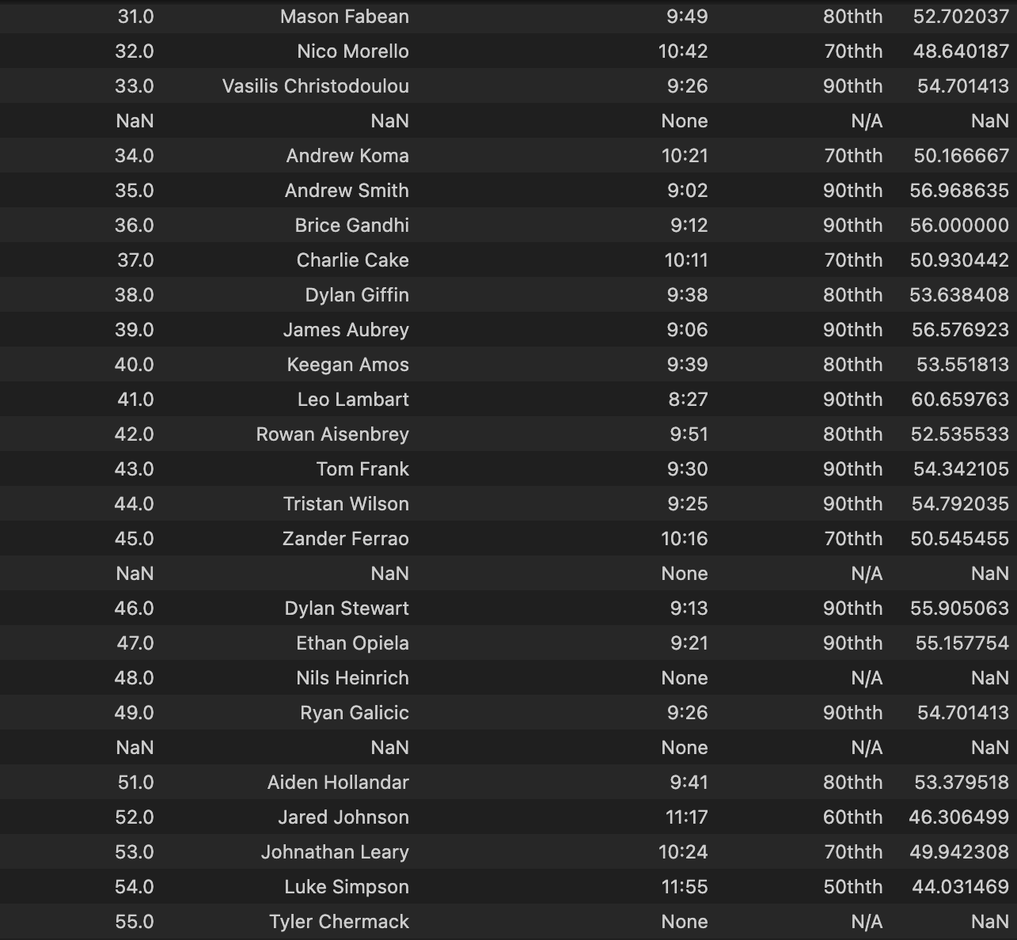
Summary 1.5 Mile Run Table
This was interesting to see. Here we have each player along with the monitor number. There were a lot of percentile rankings that were really low. We can’t have anything below 70th percentile. We would hope most of our players are at least 80th percentile with most in 90th percentile. This correlates as well with what we see for the VO2 max as mentioned earlier.
Notes:
This was interesting to see. Here we have each player along with the monitor number. There were a lot of percentile rankings that were really low. We can’t have anything below 70th percentile. We would hope most of our players are at least 80th percentile with most in 90th percentile. This correlates as well with what we see for the VO2 max as mentioned earlier.

